Slide 1
Special Applications
Valve Seat Pocket Gauging
Notes:
SPD been going for approx. 30 years, very important part of business.
Accounts for around 21% turnover giving good revenue, but also good door opener
Once solved customers difficult gauging solution can enjoy future standard gauging business
Gives the portfolio to become customers ‘Go To’ man for gauging solutions.
Team of 11 people handling quoting & order entry…all way to build & test.
Capabilities include AutoCAD 2D, Inventor 3D, CADCAM machining & modern CNC machine tools.

Slide 2
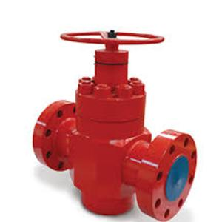
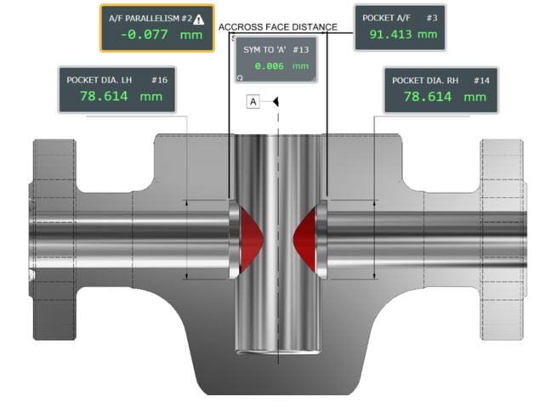
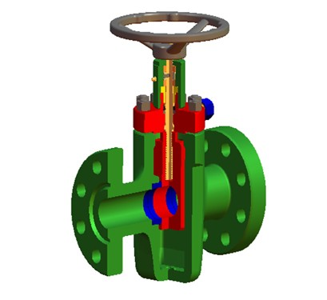
Oil & Gas Valve Cavity Measurement Supplied to Cameron / AKER Solutions

Slide 3
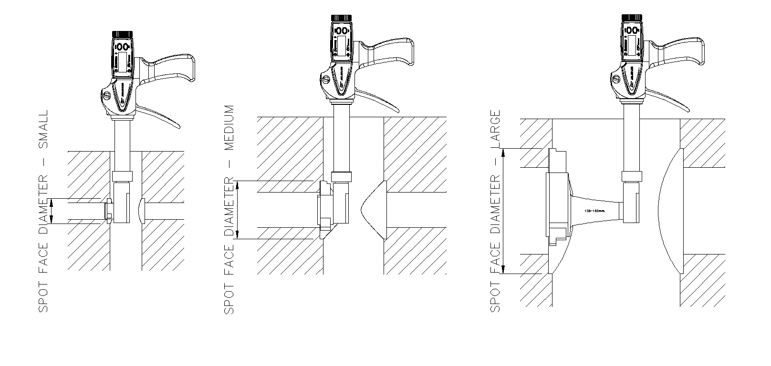
Oil & Gas Valve Cavity Measurement – Diameter
3 – point heads for self centralisation
Spherical anvil form for Speed, repeatability and ease of use

Slide 4
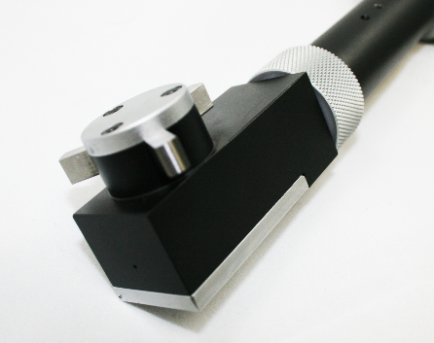
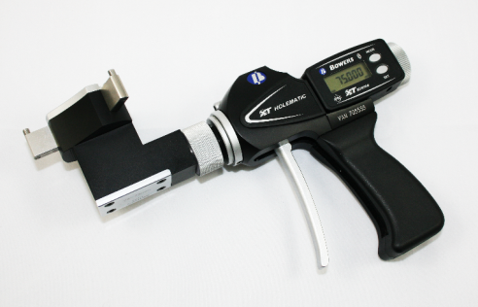
Small / medium diameter gauges with 1 or 2 piece heads
Bluetooth data transfer

Slide 5
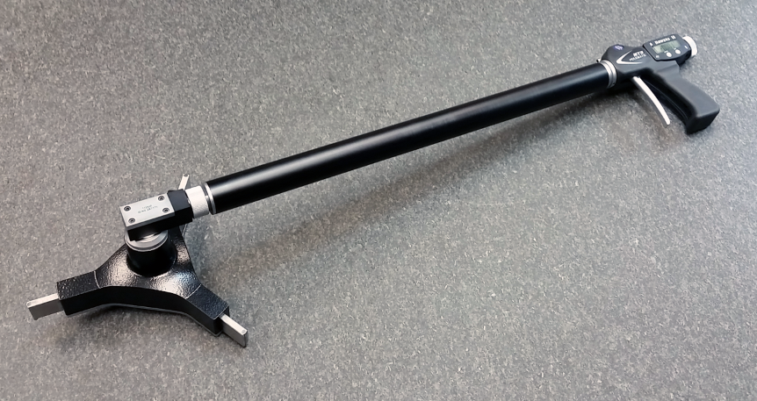
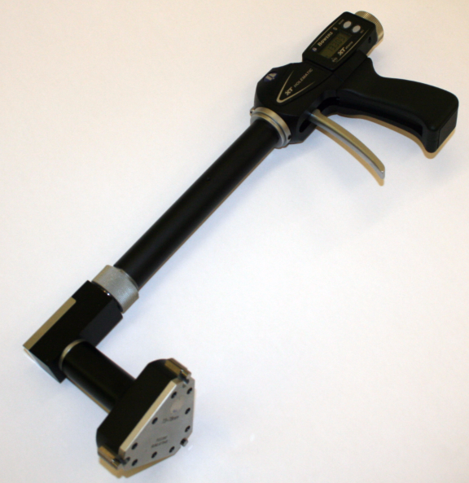
Medium / Large diameter gauges with 2 piece heads
Extended depth options 3”, 4”, 6”, 20” and 40”

Slide 6
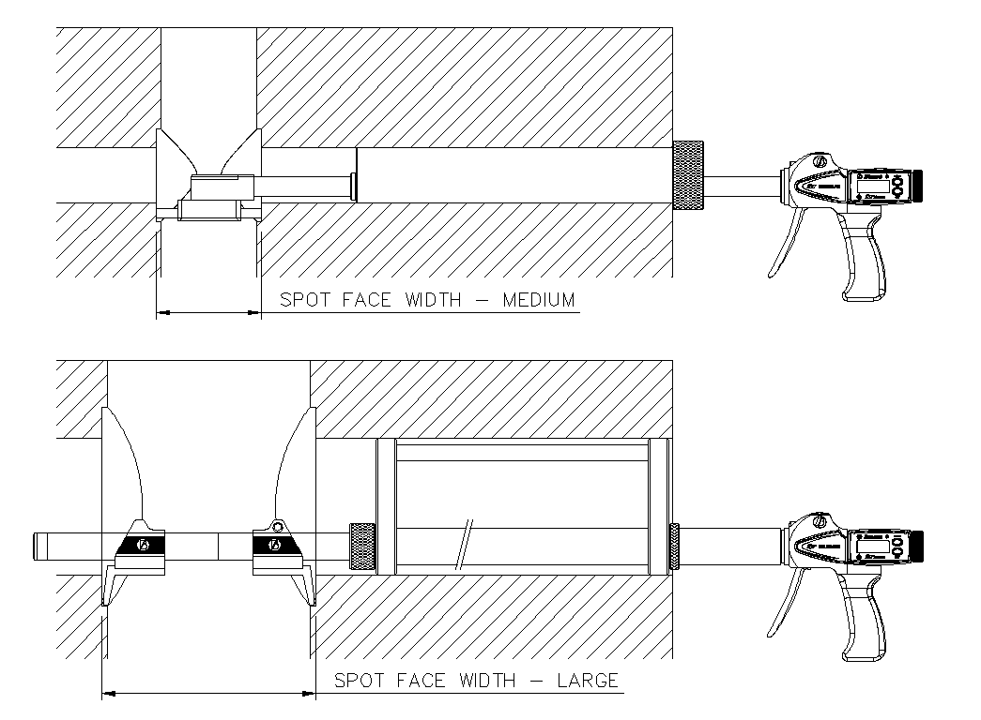
Seat Pocket – Face Width Measurement
2 Point heads with ball contacts
Measurement of pocket width and parallelism
Bluetooth option available
Extended depth to 2m+

Slide 7
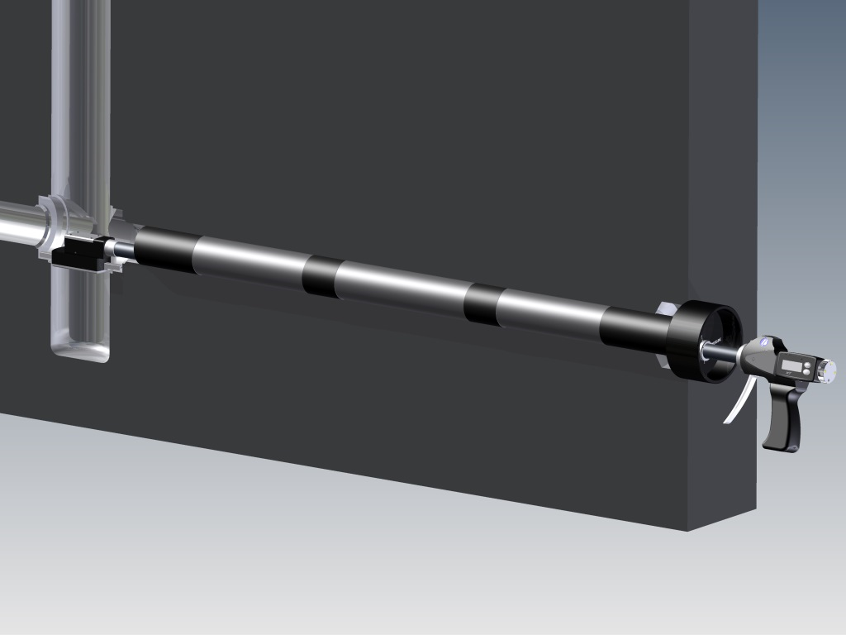
2 Point across flats measurement

Slide 8
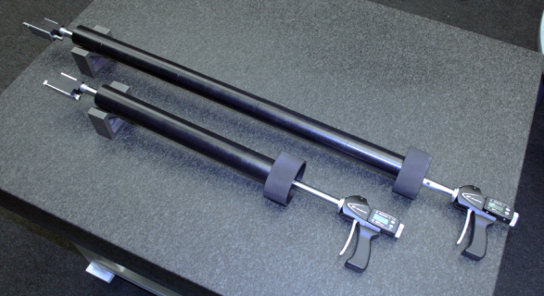
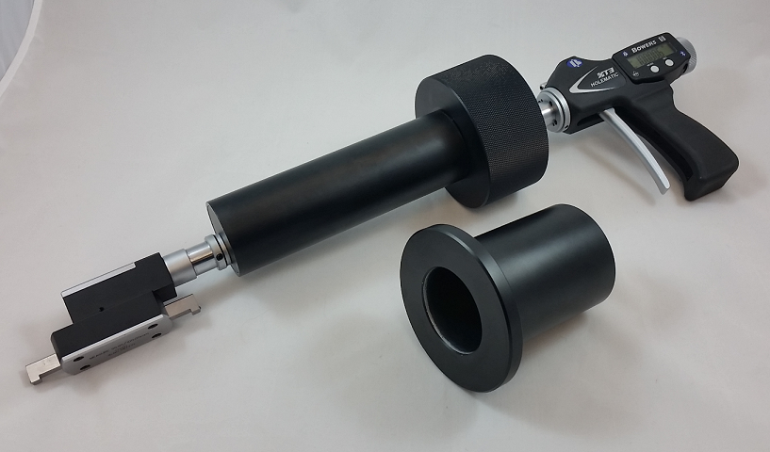
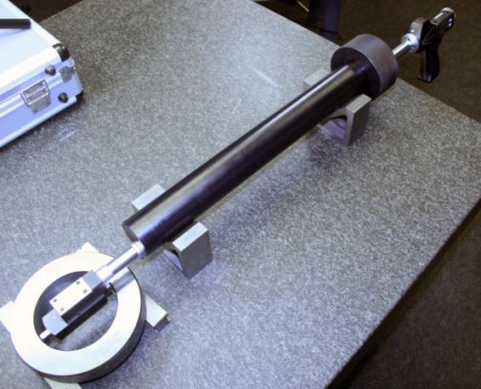
Seat Pocket – Face Width Measurement
Small type for 1-13/16 up to 3-1/8”
Depth sleeves can be added to accommodate various pocket depths.

Slide 9
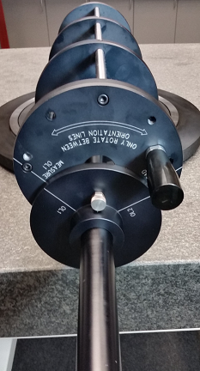
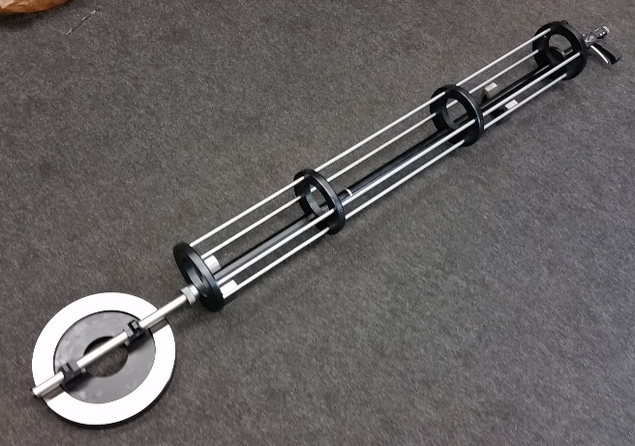
Seat Pocket – Face Width Measurement
Large type seat pocket width for 4-1/16” up to 7-1/16”

Slide 10
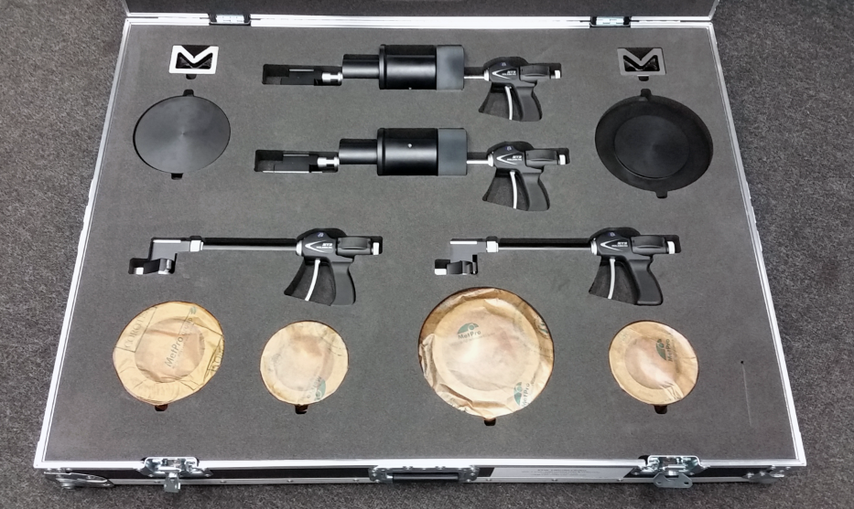
Typical set for measurement of seat pocket cavity:
DISTANCE GAUGES
CALIBRATION TOOLING
DIAMETER GAUGES
CALIBRATION RINGS

Slide 11
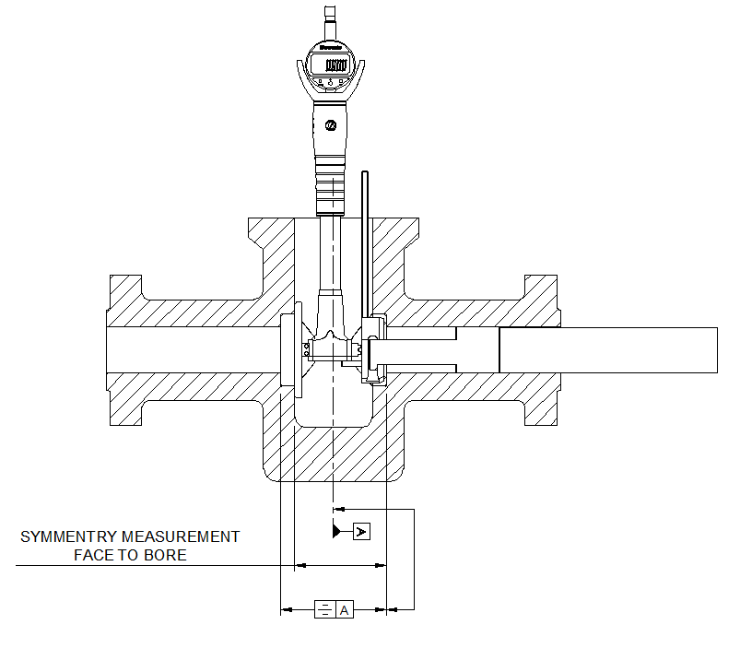
Symmetry measurement

